Slide 1
Technical workshop: Proposed INTSA implementation
14 August 2024

Slide 2
Karakia
E te whānau
Whāia te mātauranga kia mārama
Kia whai take ngā mahi kātoa
Tū māia, tū kaha
Aroha atu, aroha mai
Tātou ki a tātou kātoa
For this family
Seek knowledge and understanding
Have purpose in all that you do
Stand tall, stand strong
Let us show respect
For each other

Slide 3
Purpose of workshop
To share and test our current thinking on the implementation design for the draft Innovation and non-traditional solutions allowance (INTSA). We want to ensure any requirements we build into the determination are workable and proportionate.
We wish to hear from participants about how we can develop an INTSA process that encourages EDBs to innovate and provide benefits to consumers:
Application process steps
Guidance materials
Project Eligibility Assessment Template
INTSA webpage on Commission website
Please note: We are still considering submissions and cross-submissions on the draft DPP4 decision and determination, including in relation to the draft INTSA. This means that all guidance, discussion, and material for this workshop are based on the draft INTSA requirements from the draft DPP4 determination that we consulted on and may be subject to change if submissions and/or cross-submissions prompt us to change the draft INTSA.

Slide 4
Session 1: Recap of draft INTSA policy design

Slide 5
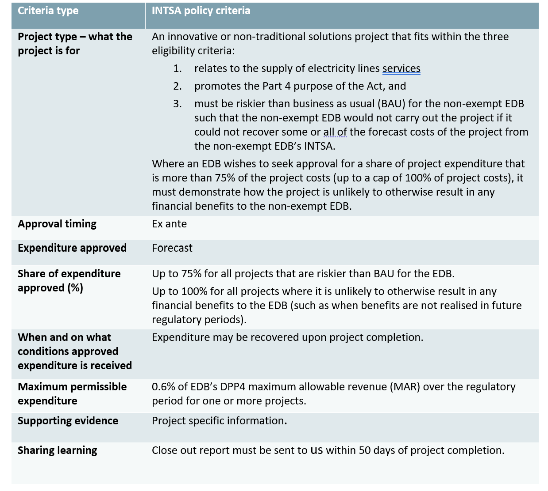
Intention and design of the draft INTSA
We published the following in our DPP4 Draft decision reasons paper (29 May 2024).
The INTSA policy characteristics described to the left are detailed in the Draft DPP4 Determination (see Schedule 5.3 from page 74 here)

Slide 6
What we heard from stakeholders on the implementation of the proposed INSTA
In terms of views on implementation aspects, we heard, for example:
Issues paper (Electra) - “We encourage the Commission to release an innovations and non-traditional solutions allowance process or a guide as part of the DPP4 reset.”
Workshop (WE*) – “The INTSA scheme should be supported by an overall framework for coordinating projects across EDBs and for sharing results. EDBs should present the results to stakeholders, providing the opportunity to ask questions and understand the results.”
Draft (Orion) – “We support the release of guidance and a voluntary template to support EDBs to apply for INTSA projects in an efficient manner.”
We also heard specific feedback for what to include in the PEA/guidance document as well as multiple suggestions for a deadline for the Commission to process applications.
We are keen to explore these points (and more) in today's workshop

Slide 7
Session 2: Proposed INTSA implementation design

Slide 8
INTSA process
Key:
EDB/s
Commission
Start
The (voluntary) Project Eligibility Assessment (PEA) template and INTSA application guidance will be on the Commission’s website.
1. Submit INTSA application (PEA)
Not (yet) approved
This will include requesting further (voluntary) information if needed, and determining whether the project, if eligible, would attract either 75% or 100% recovery of costs. We would advise the EDB and make our decision public on our website.
2. Consider application, inform EDB/s of decision
Questions/comments:
Are there extra steps that we could consider that would make the INTSA easier to use, and more beneficial for consumers?
Does this process reflect your understanding of the determination?
Approved
3. Complete project and recover forecast cost
On completion of the project (defined as project outputs being delivered) the EDB/s would then be able to recover the approved forecast costs and they can enter the wash-up balance for that year as an actual recoverable cost.
4. Publish close out report
Within 50 working days of completing the project, the EDB/s must complete a closeout report and send it to us. Completing a project means delivering on INTSA outputs. We would publish this on our website.
End

Slide 9
Step 1: Submit INTSA application
Start step 1
Key:
1. EDB has innovative or NTS idea
EDB/s
Commission
2. Consider the requirements in the determination and the Commission’s INTSA guidance
Commission to publish guidance by 01/04/25
The PEA template and INTSA application guidance will be on the Commission’s website before 1 April 2025 (start of the DPP4 period).
Publication
Commission to publish PEA template by 01/04/25
Creating a proposal and completing a voluntary PEA template, or other medium of application that sets out how the application meets the requirements in the determination.
3. Complete the INTSA proposal
Questions/comments:
We had some feedback that collaborative Applications should be encouraged further.
What would your views be for increasing the maximum permissible expenditure from 0.6% (e.g. to 1%) - but ring fencing this increase in cap for projects involving more than one EDB?
4. Submit the proposal to the Commission
The EDB would submit its proposal to the Commission by email to the Infrastructure.Regulation inbox, including a confidential and public version if needed.
Move to step 2

Slide 10
Step 2: Consider application, inform
Key:
Start step 2
EDB/s
1. Receive application
We will receive the application via email from the submitting EDB.
Commission
2. Assess application
After receiving the application, we will both publish the application on our website and seek to assess it as soon as practicable.
4. Provide any further information on request
3. Seek further information (only if needed)
It is likely that further information would only be asked for when it’s relevant to the specific application and is proportional to the project cost/complexity.
Questions/comments:
An EDB's application must include sufficient information to enable us to decide whether the INTSA criteria are met. We may in certain circumstances request (voluntarily) clarification or further information, if appropriate.
EDBs would not be required to publish their applications when they send them to us, but we encourage doing so.
4. Inform EDB/s of application outcome
We will inform the EDB of the outcome of their proposal, and if successful, whether it is eligible for 75% or 100% of costs recoverable. At the same time, we will publish our decision on our website.
Move to step 3

Slide 11
Step 3: Complete project
Key:
Start step 3
EDB/s
Commission
1. Commence the project
The project should be commenced as per the plan which was submitted to us using the PEA or other template.
During its course and once project is completed, EDBs should assess the project outputs and outcomes, and whether it is on track to achieve its purpose and provide benefits for consumers.
Questions/comments:
A project may not always go as planned. However, provided the project’s INTSA outputs are delivered, the costs of the project may be recovered up to the amount approved.
Should there be other form of communication between the Commission and EDBs during or after project’s completion (not including the closeout report)?
3. Complete the project
4. Recover costs
With the project completed, shown by the outputs being delivered, the EDB may recover the approved forecast costs.
Move to step 4
11

Slide 12
Step 4: Publish close out report
Key:
Start step 4
EDB/s
1. Draft project closeout report
Write the close-out report.
Commission
The project close-out report will need to outline whether and how the project purposes was achieved (if not why not); any SAIDI/SAIFI values relating to the project and their causes; steps taken to reduce any interruptions; and any insights gained from the project that might assist the EDB or other EDBs.
2. Ensure report complies with schedule 5.3
Questions/comments:
The closeout report needs to meet the content requirements in the determination. The closeout report is the primary means of sharing learning, and it is important that others can learn from it.
Are there further requirements we can ask for to create a comparable level of quality or set a standard among close out reports?
3. Send it to the Commission
Within 50 working days of project completion, EDB would send its report to us, including a confidential and public version if necessary.
4. Publish it on our website.
We will publish the public version of the report on our website. We encourage the EDB to do the same, although this would not be required.
Move to step 5

Slide 13
INTSA Guidance
What is needed:
Published guidance to support EDBs wishing to apply for the INTSA.
Our proposed approach:
Draft guidance and a PEA that is clear and easy to follow for how to apply for the INTSA.
Once the Final Determination is issued – we will update this guidance and the PEA as required, and then publish them both on an INTSA specific section of the Commission’s website before 01/04/25.
Rationale for approach:
Stakeholders asked for guidance for the INTSA in response from submissions, noting that the IPA was/is not always clear.
Guidance should improve the efficiency of application processes for both EDBs and the Commission.

Slide 14
Project eligibility assessment (PEA) form
What is needed:
A standardised template/form that EDBs could choose to use in their application for an INTSA to demonstrate how their project meets the criteria in the determination.
Our proposed approach:
Design a voluntary PEA template that captures the necessary and helpful information for making an INTSA application.
Upload this to the Commission website before 01/04/25.
We would update it when and where necessary.
Rationale for approach:
Submitters asked for guidance and clarity for the INTSA application process – we consider the PEA is part of this guidance.
Questions:
Are there any challenges with providing the information as set out in the determination?
What other information could help demonstrate a project’s eligibility?
Would EDBs use a PEA, or would they be more likely to apply using their own format?

Slide 15
Webpage publication
What is needed:
A location where EDBs can source the information they need to prepare and submit an application, and where stakeholders can access all INTSA projects.
Our proposed approach:
Create a dedicated Commerce Commission webpage that:
Holds the PEA template and INTSA guidance
Could host an application portal (ie a function where applications can be submitted to the Commerce Commission and from where they can receive confirmation messages), or a dedicated email address
Publish the close out reports from EDBs who have completed project part funded by IPA (in DPP3) or INTSA (from DPP4).
Rationale for approach:
Having a one-stop-shop for all INTSA projects should be helpful for the sector, the Commission and consumers.
Questions:
Should there be greater visibility over open applications?
Is there a role for the ENA or other forum to promote/share INTSA learnings?

Slide 16
Open question and answer session
Please feel free to raise your hand, or write a question into the chat about any of the topics we have traversed in this workshop.
Note that stakeholders have a formal consultation period in which to provide further, written feedback by 28 August 2024.

Slide 17
Workshop close and karakia

Slide 18
Submissions and next steps
We welcome your views on the questions asked in this workshop, or on other matters relevant to the implementation design and application process for the draft INTSA. This includes the draft PEA and guidance.
Written feedback is due by 5pm on Wednesday, 28 August 2024.
Responses should be addressed to:
Ben Woodham, Electricity Distribution Manager
c/o infrastructure.regulation@comcom.govt.nz
Please include “Submission on EDB DPP4 innovation and non-traditional solutions workshop – implementation design” in the subject line of your email.
We prefer submissions in both a format suitable for word processing (such as Microsoft Word document) as well as a ‘locked’ format (such as a PDF) for publication on our website.
Draft Determination and Reasons paper May 2024
We are here Implementation workshop
1 April 2025
DPP3 – Innovation project allowance
DPP4
Final Determination and Reasons paper November 2024

Slide 19
Closing karakia
Kua mutu, a mātou mahi
Mō tēnei wā
Manaakitia mai, mātou katoa
O mātou hoa
O mātou whānau
Āio ki te aorangi
Our work has finished
For the moment
Bless us all
Our colleagues
Our families
Peace to the universe

